Slide 1
Hack3D 2020
Reverse Engineering a mesh based Deformed part file
By: DC-War-Story

Slide 2
Problem statement
We are provided with a mesh file of a deformed part (brick) on which a static study was run.
It was noted that the mesh file had lost features on the underside.
Study performed was to simulate the stresses experienced by the brick, when stepped on by an adult.
We are also provided with a reference JPEG file, of the legend and color map distribution of the stress, however no units were disclosed.

Slide 3
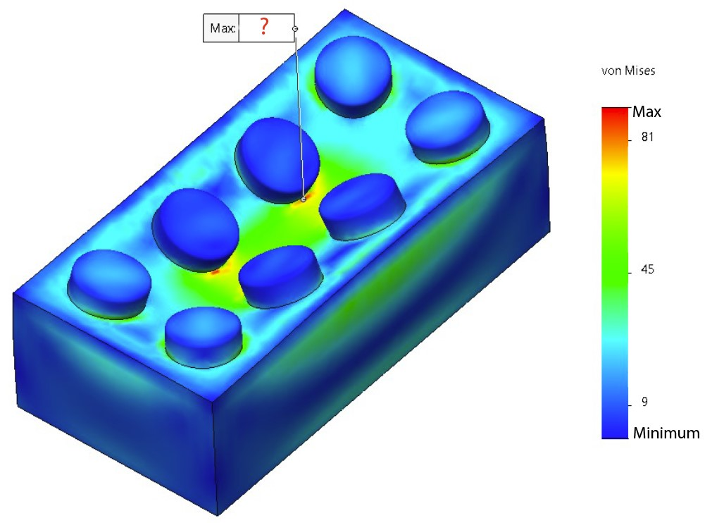

Slide 4
What we are asked to do
Reconstruct the brick (close to the original file dimensions) which can stack on top of each other.
Gather the Simulation Data, with the Max stress and units.

Slide 5
Analysis
VRML Mesh file included, carried the information of stress in the form of deformation and a color map on the surface.
Found 2 Alpha-numeric codes on the underside 2-252 & L1 38564.
Reference JPEG file provided a legend with numbers. Scaling the legend using the distance between the numeric markings, max stress was found to be 90 units. The unit was yet to be determined.

Slide 6
Reverse Engineering
Finding the Dimensions:
Features that were given:
• Elemental Length Summation for length, width and height of various kinds
• Finding the Minor radius of Ellipse
• Mean value for circular sections
Features that we had to make:
• Height of tubes to the bottom surface
• Clearance of tubes from Studs
• Inner Radius of tubes

Slide 7
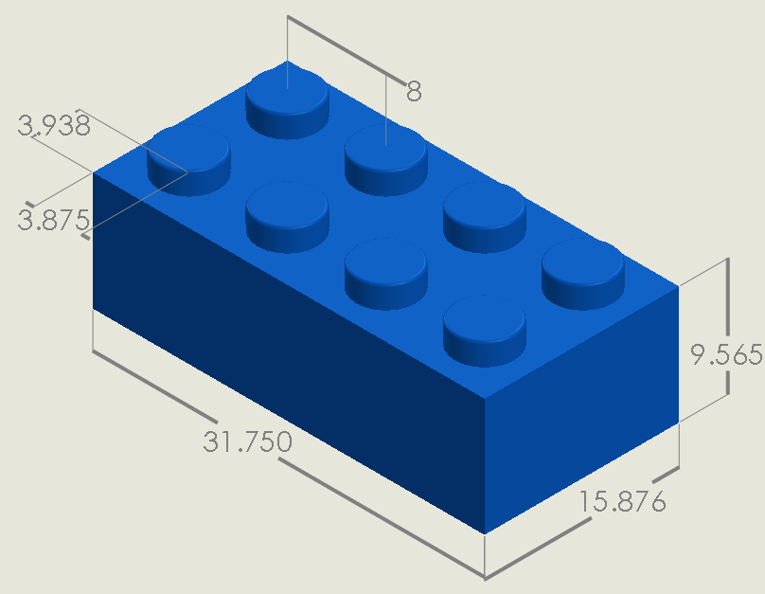

Slide 8
Values determined
Brick/Cuboid:
•Length- 31.750 mm, Width- 15.876 mm, Height- 9.565 mm, Shell – 1.2 mm
Stud:
•Radius – 2.4 mm, Height – 1.8 mm Fillet – 0.12 mm
•Distance between two studs (centre to centre) – 8 mm
Tube:
•Radius (Outer) – 3.255 mm, Radius (Inner) – 2.4 mm
•Height – From the top surface to ground.

Slide 9
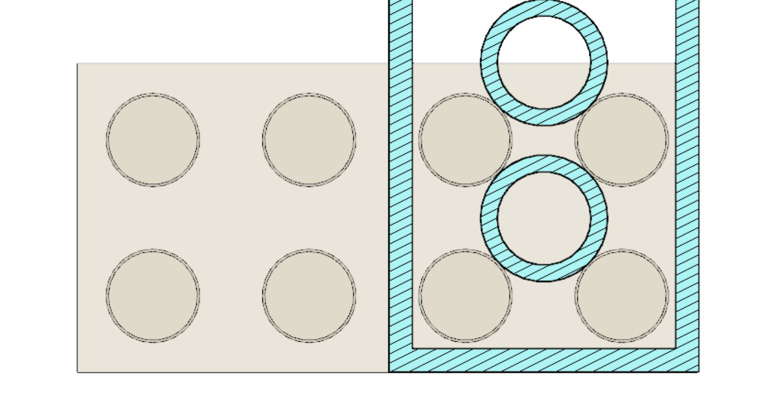
Stacking bricks on each other

Slide 10
Simulation Study
Determination of constraints to perform the study.
Weight of adult not equal to Force applied
Numeric scale of the legend = target
Units used across CAD Softwares uniform [PSI, KSI, bar, MPa, Pa]
Deformation not of true scale- VRML mesh file
Behaviour of deformation

Slide 11
Deformation not of true scale
Extraction of a similar simulated mesh led to following findings:
The mesh produced was deformed on a custom/ automatic scale, however the behaviour of the surface under stress was similar.
VRML File only had only the mesh describing the brick and no reference geometry. Led us to believe the simulation was done using brick’s bottom face as fixed geometry
Iterative simulation data showed MPa as the missing units on the legend. Remaining units corresponded to an adult weight out of our defined range.

Slide 12
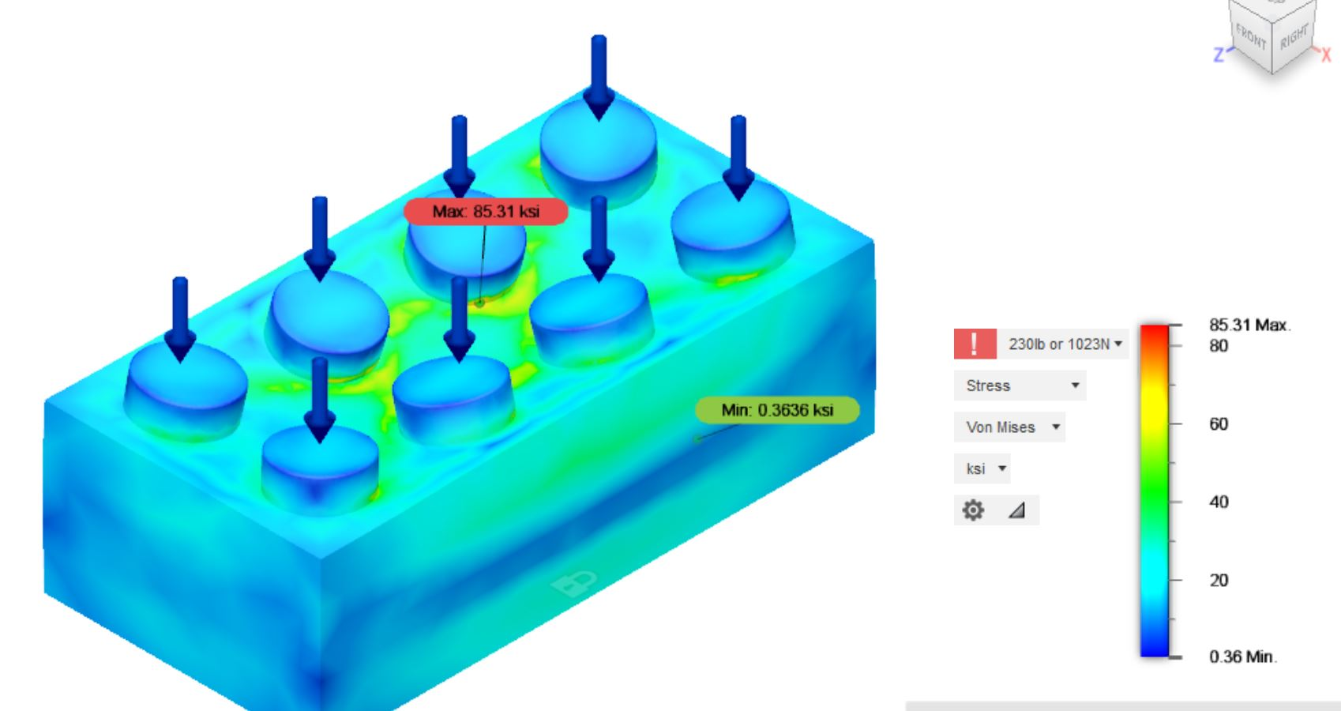
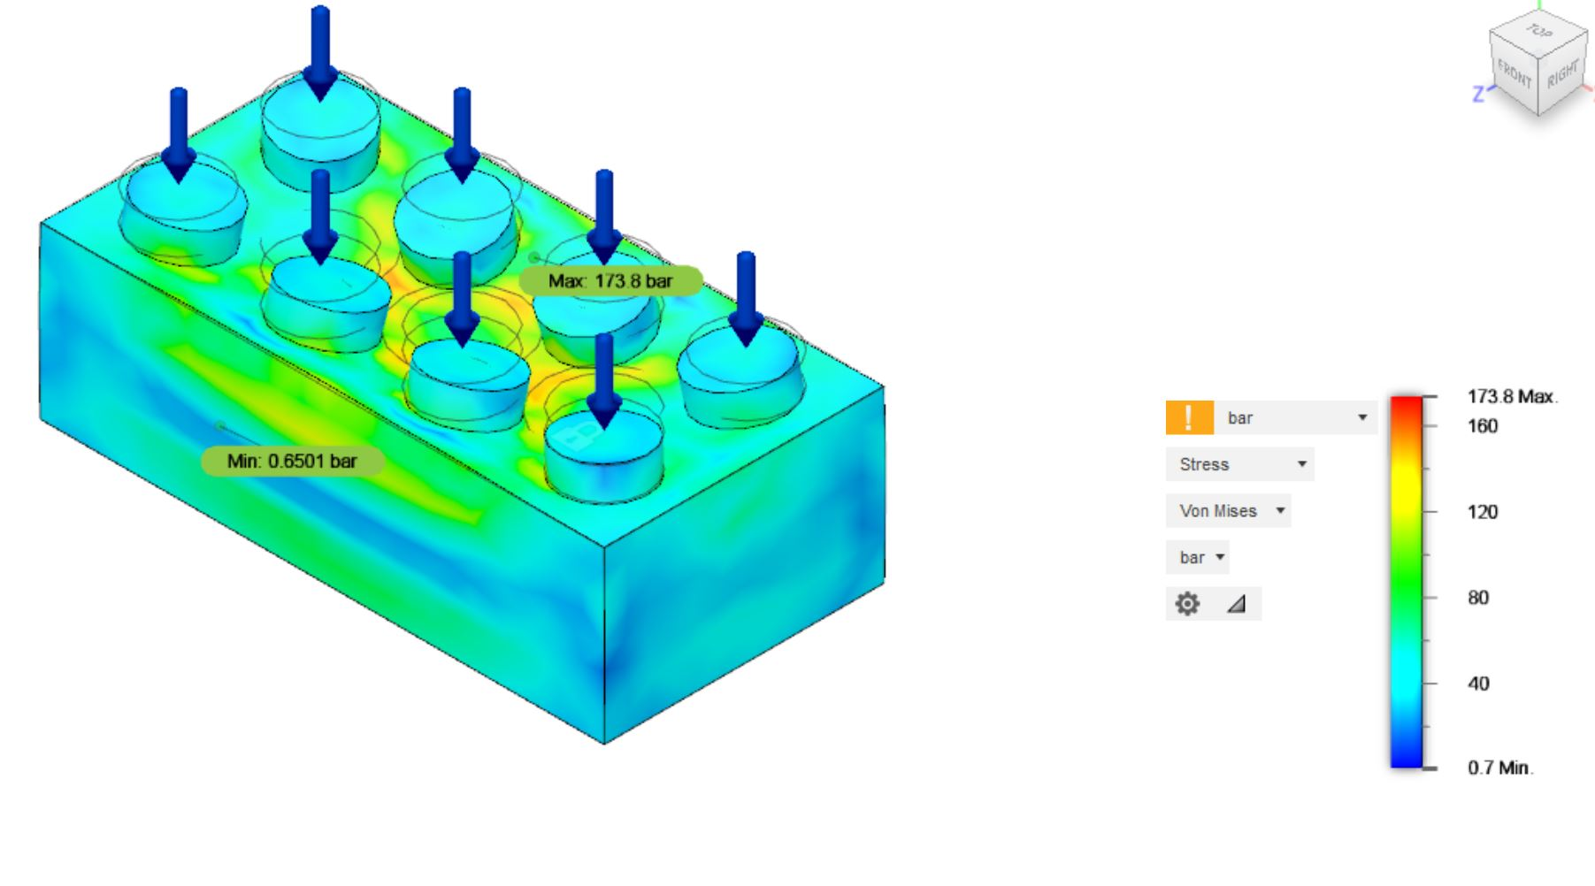
KSI - required a 1400 lb-force to produce a similar legend
Bar - required a force of 300N to produce a similar legend

Slide 13
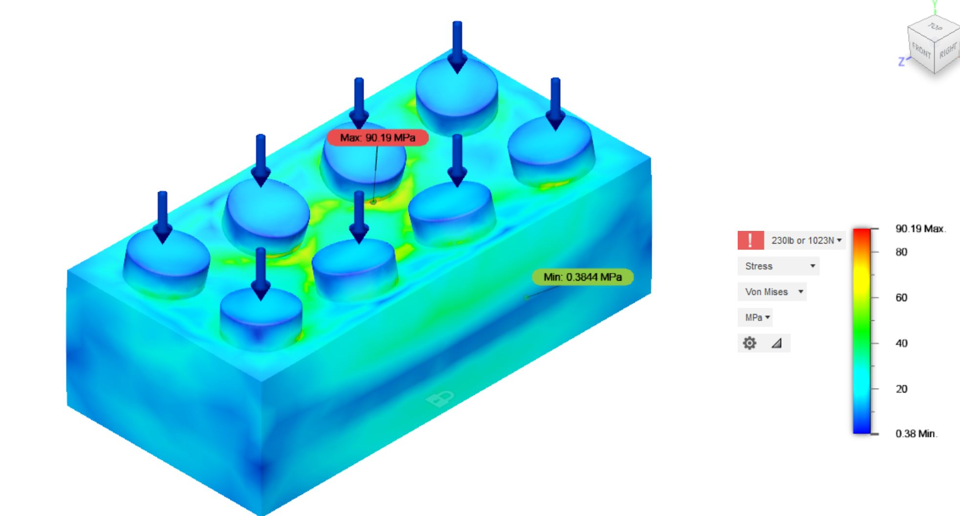
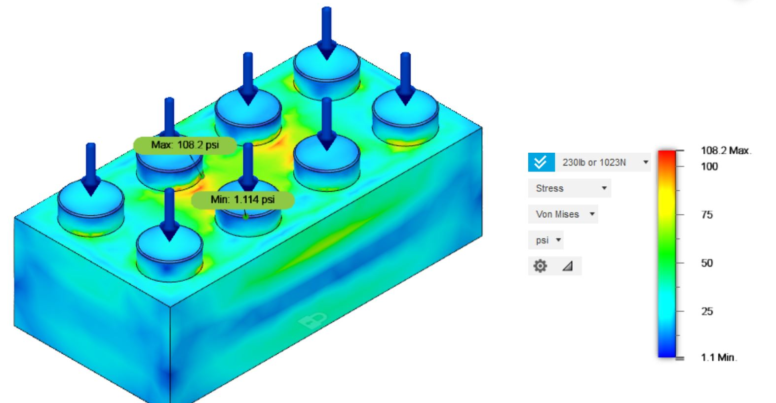
PSI - required a 2 lb-force to produce a similar legend
MPa - required a 230 lb-force to produce a similar legend

Slide 14
Deformation Behavior
Under the stress applied, bricks with varying geometry would show deformation of characteristic behaviour, specific to that geometry.
This information was utilised to identify similar deformation behaviour across our proposed set of models

Slide 15
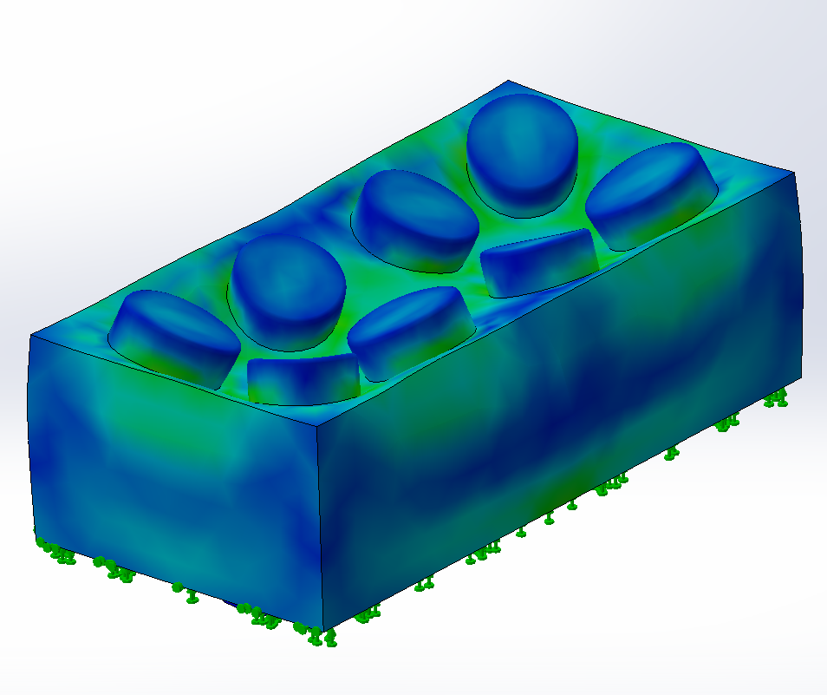
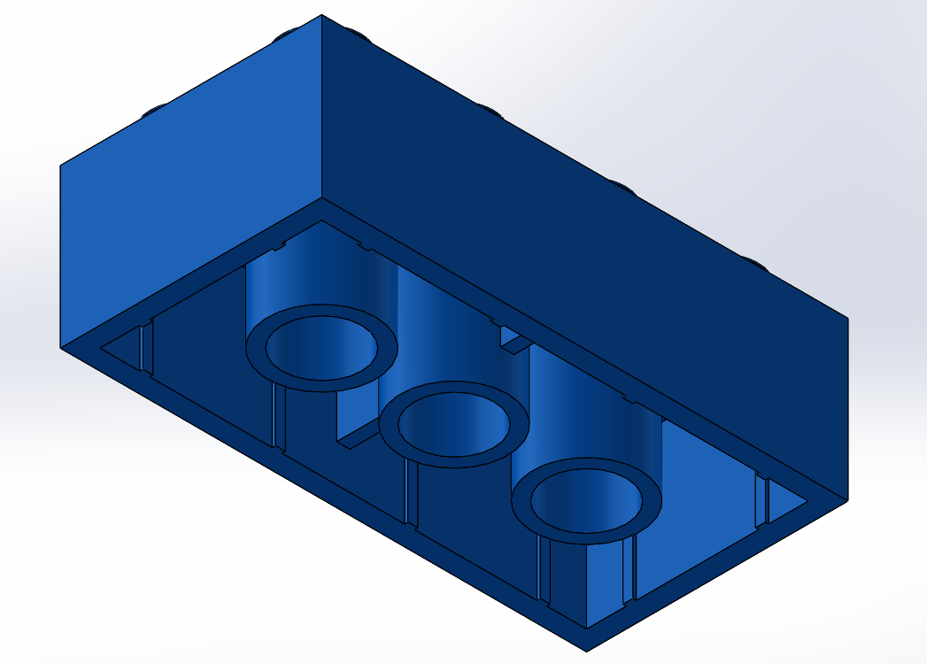
Brick with Rib joining the middle tube to the Walls

Slide 16
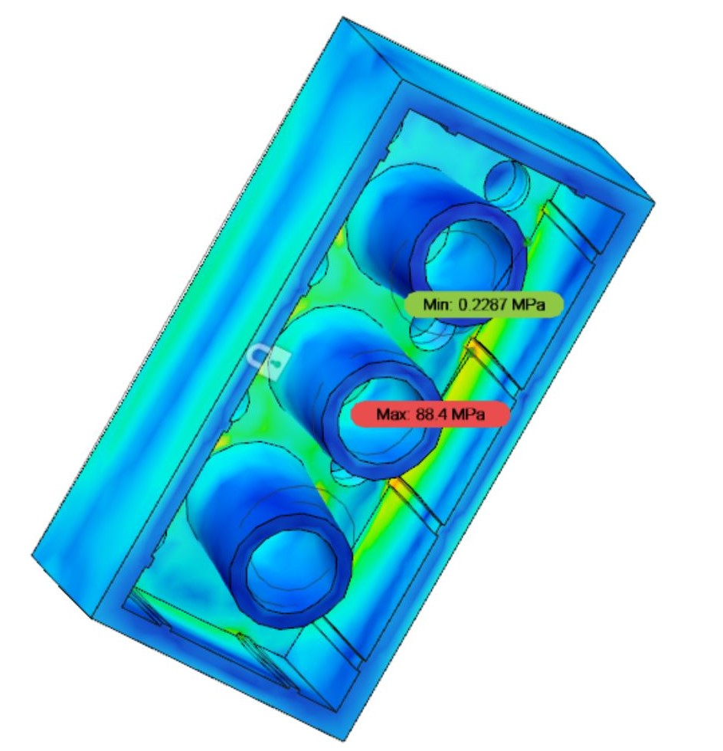
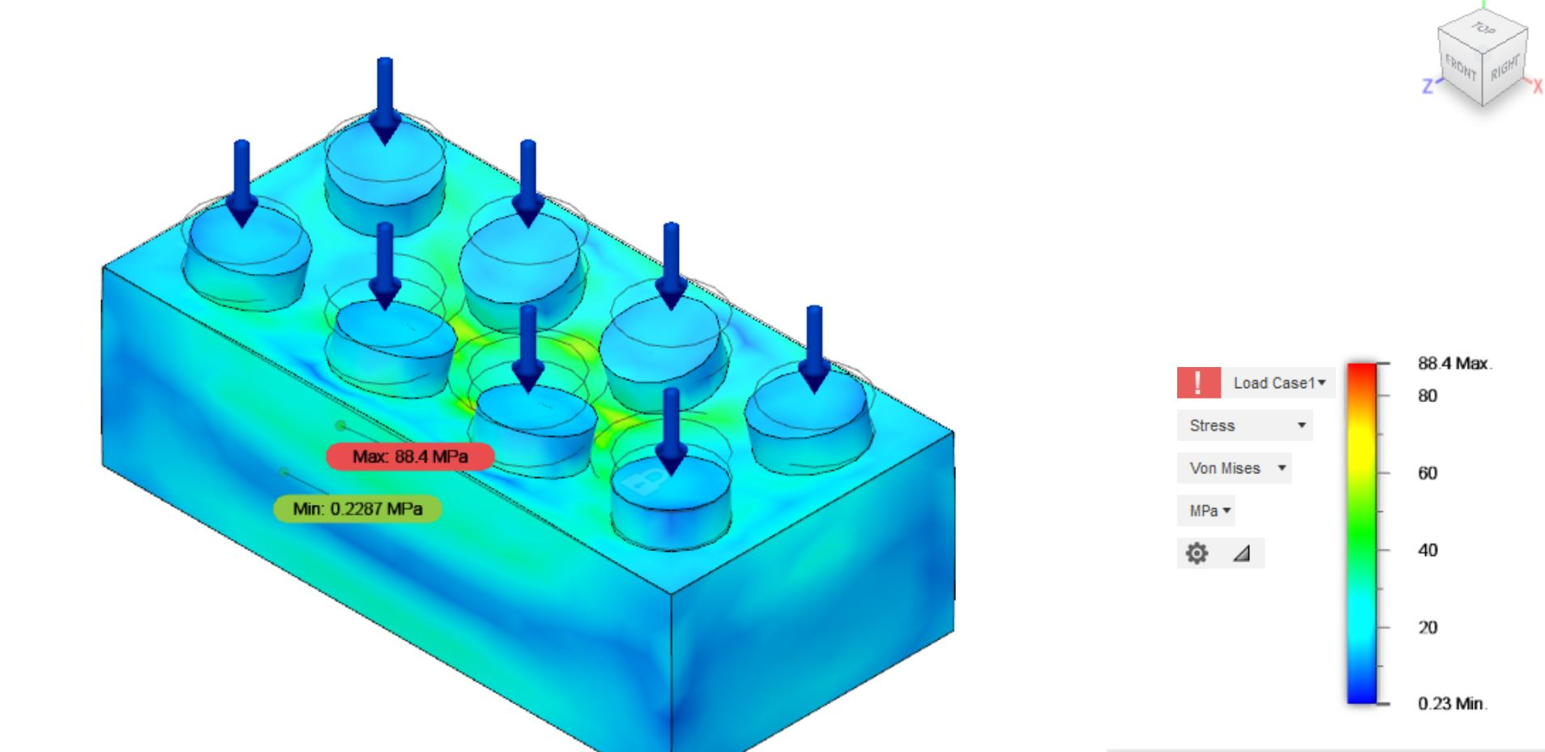
Brick with grooves on the interior side of the Walls

Slide 17
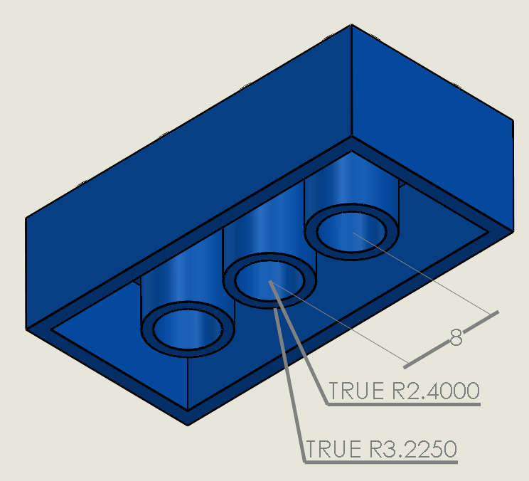
Final part dimensions

Slide 18
Thank You
By: Chirayu Rankawat, Devansh Garg

